Slide 1


By: Christabelle Fu, Arjun Kalyan, Rhyle Majarais and Sandeep Saldanha

Slide 2
WHAT ARE WE DOING?
We are making a Das Invaders game which includes high performance shooting.
It is a Java based program which uses a GUI interface to run the program.
Some of the main components we used in our program are:
JFrames, JLabels, arrayLists, threads, while loops, for statements, methods, a KeyListener, a MouseMotionListener, Math.random() methods, and ImageIcons

Slide 3
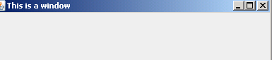
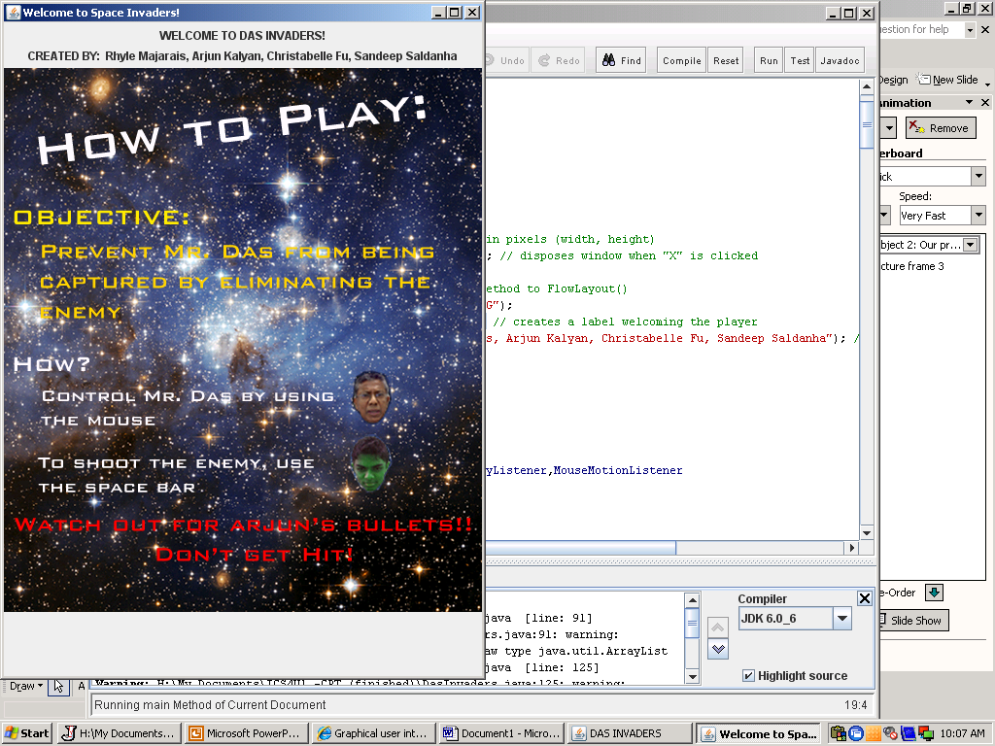
Our program uses the GUI interface to display the program.
This interface allows a user to interact with a program
To make a window, we used the JFrame method
EX. JFrame window = new JFrame(“This is a window”);
We used JLabel to display text and images without letting the user change it
EX. JLabel welcome = new JLabel("WELCOME TO DAS INVADERS!");

Slide 4
KeyListener is an interface component that listens for keyboard events (keys that are pressed)
To make component register, you must include the “addKeyListener” method
When a key is pressed, the program then goes to the keyPressed,keyReleased, and keyTyped methods which tells the computer what to do
MouseMotionListener is an interface component that listens for movements of the mouse
Once again, to make this component register, you must include the “addMouseMotionListener” method
The program then goes to the mouseDragged and mouseMoved methods when it detects movements from the mouse

Slide 5
ArrayLists are similar to arrays
They hold classes and are used when you do not know the specific number of elements you need to hold
ArrayLists have something called a capacity which is the size of the array that is used to store lists
when more elements are added to the ArrayList, the capacity of it expands
To import images into the program, you must use the line :
“ImageIcon howToPlay = new ImageIcon("howToPlay.png");”
This line imports the image named “howToPlay.png”

Slide 6
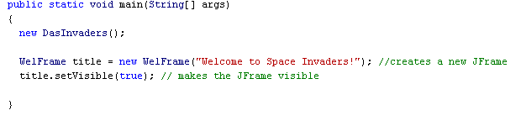
Explanation of Our Program
This is the main method of our program
It creates a JFrame for the welcome screen that pops up when the game runs
title.setVisible(true); makes the JFrame visible

Slide 7
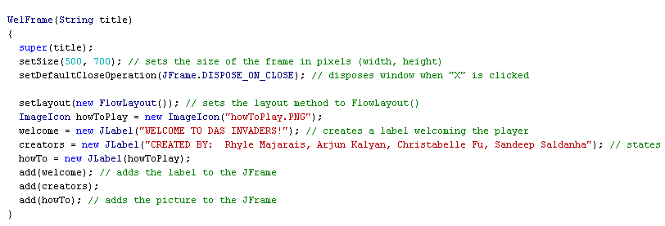
setDefaultCloseOperation(JFrame.DISPOSE_ON_CLOSE);this gets rid of the window when the user clicks on the “X” at the top right corner without stopping the whole program
setSize(500, 700); sets the size of the window to 500 by 700 pixels (width x height)
setLayout(new FlowLayout()); sets the layout method to FlowLayout();
welcome = new Jlabel(“WELCOME TO DAS INVADERS”); creates a label welcoming the user
add(welcome); adds the “welcome” JLabel to the window

Slide 8
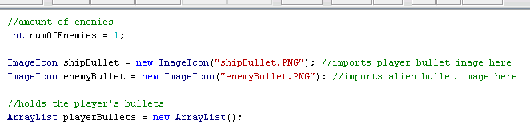
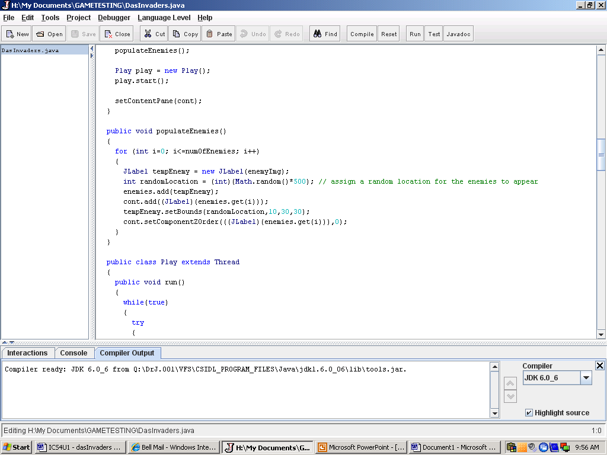
This ArrayList holds the number of player bullets
Math.random() assigns a random location for enemies to appear
setBounds sets the location of the enemy

Slide 9
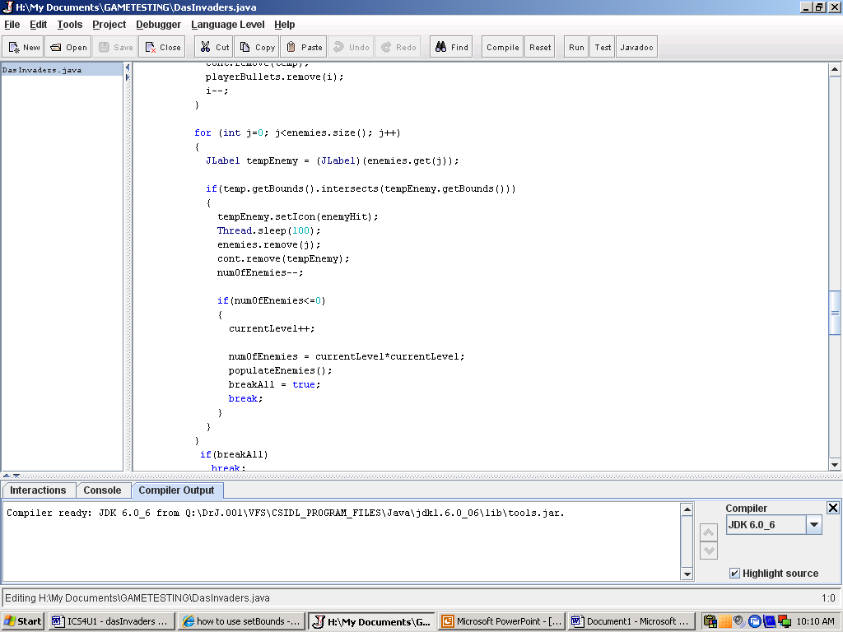
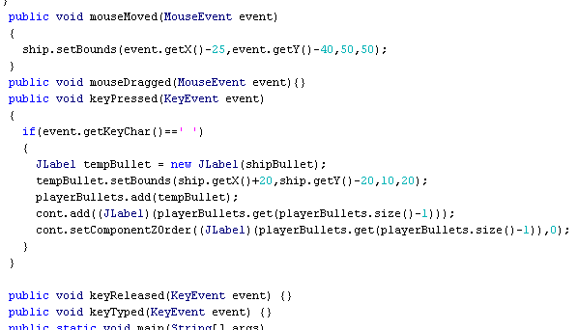
Thread.sleep(100); causes the current thread to suspend for 100 milliseconds
when the number of enemies becomes zero, the player advances to the next level and the program uses the populateEnemies() method to add more enemies to the game
This is a portion of the KeyListener and the MouseMotionListener events
It detects movements of the mouse and keys that were pressed and responds to it

Slide 10
Problems We Encountered
We had trouble deciding what program we were going to make and whether it should be done on Python and Java
Typing errors caused our program not to compile
Images wouldn’t load properly
We originally included power ups and health packs into our game however, since the computers were so slow, we had to get rid of those components

Slide 11
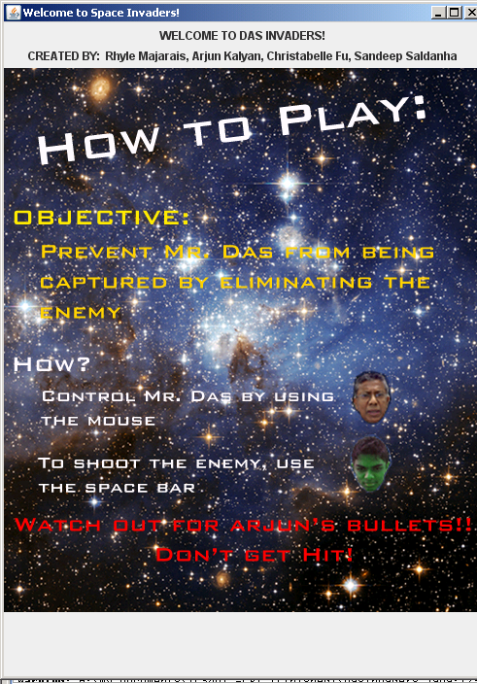
This is the welcoming window that pops up when Das Invaders is run

Slide 12
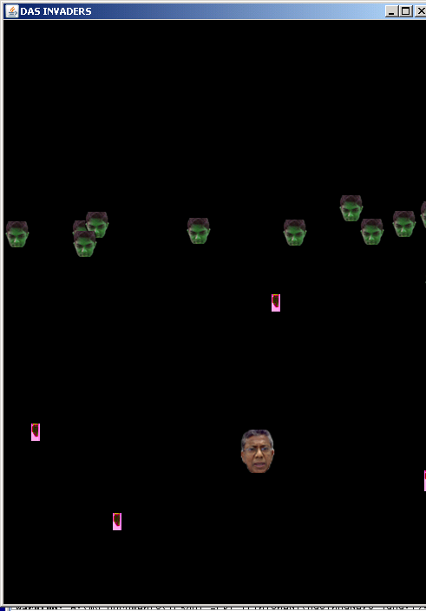
This is an image of the game being played

Slide 13
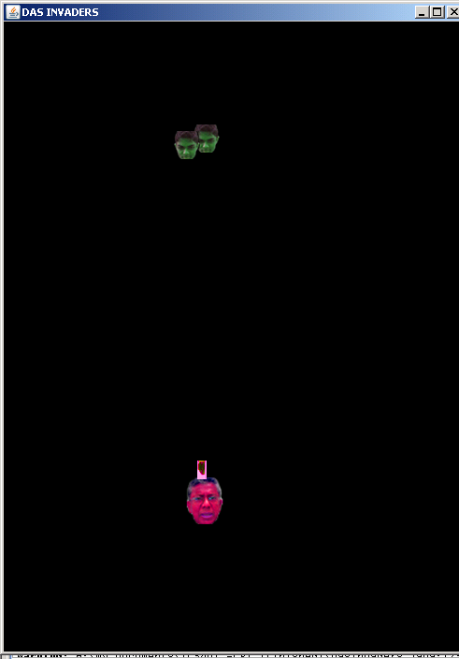
This is what it looks like when the player gets hit

Slide 14
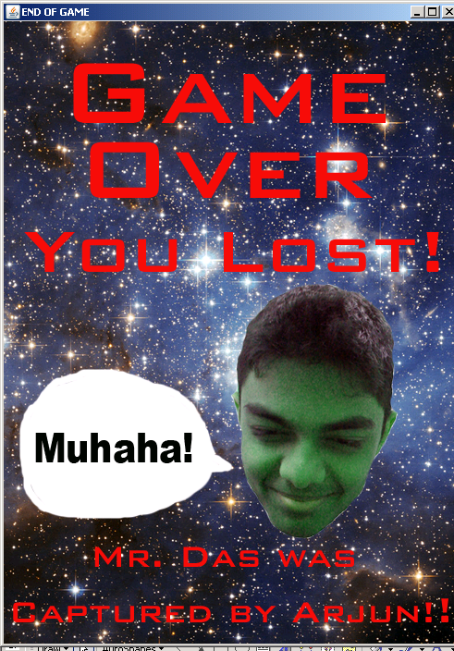
When the player gets shot, the Das Ship gets captured by the Arjunations

Slide 15
REFERENCES
http://java.sun.com/j2se/1.4.2/docs/api/java/lang/package-summary.html
http://chortle.ccsu.edu/CS151/cs151java.html
http://java.sun.com/docs/books/tutorial/uiswing/
http://www.java-tips.org/java-se-tips/java.lang/use-of-arraylist-class.html
http://www.wirelessdevnet.com/channels/java/training/javagui.html

